Slide 1
Online Blogging System
Bisham Raj Pandey-15
Bishal Regmi-14

Slide 2
Introduction
A blogging system is a system to blog about any topic a user wants
Blogs can be created easily in this system
It will include a liking and commenting system
It will also include a direct messaging system

Slide 3
Problem Statement
Sites are not Responsive
Lack of moderation
Lack of communication with creator
Spread of misinformation

Slide 4
Objectives
To develop a web-based responsive blogging system that provide blogging platform to the customers.
To keep record of all the information of all blogs, bloggers, likes, and comments.
To allow users and bloggers to chat/dm with each other

Slide 5
Requirement Analysis
Problems of current system
It is hard for the system to check and filter spam comments.
The process of receiving feedbacks on blogs is hard.
It is difficult to moderate content on the systems.
Advantages of Proposed system
The moderators will help to make clean, safe and correct content
The blogger can creates and edit blogs easily.
All the records of the blogs, comments and likes will be stored in the database.

Slide 6
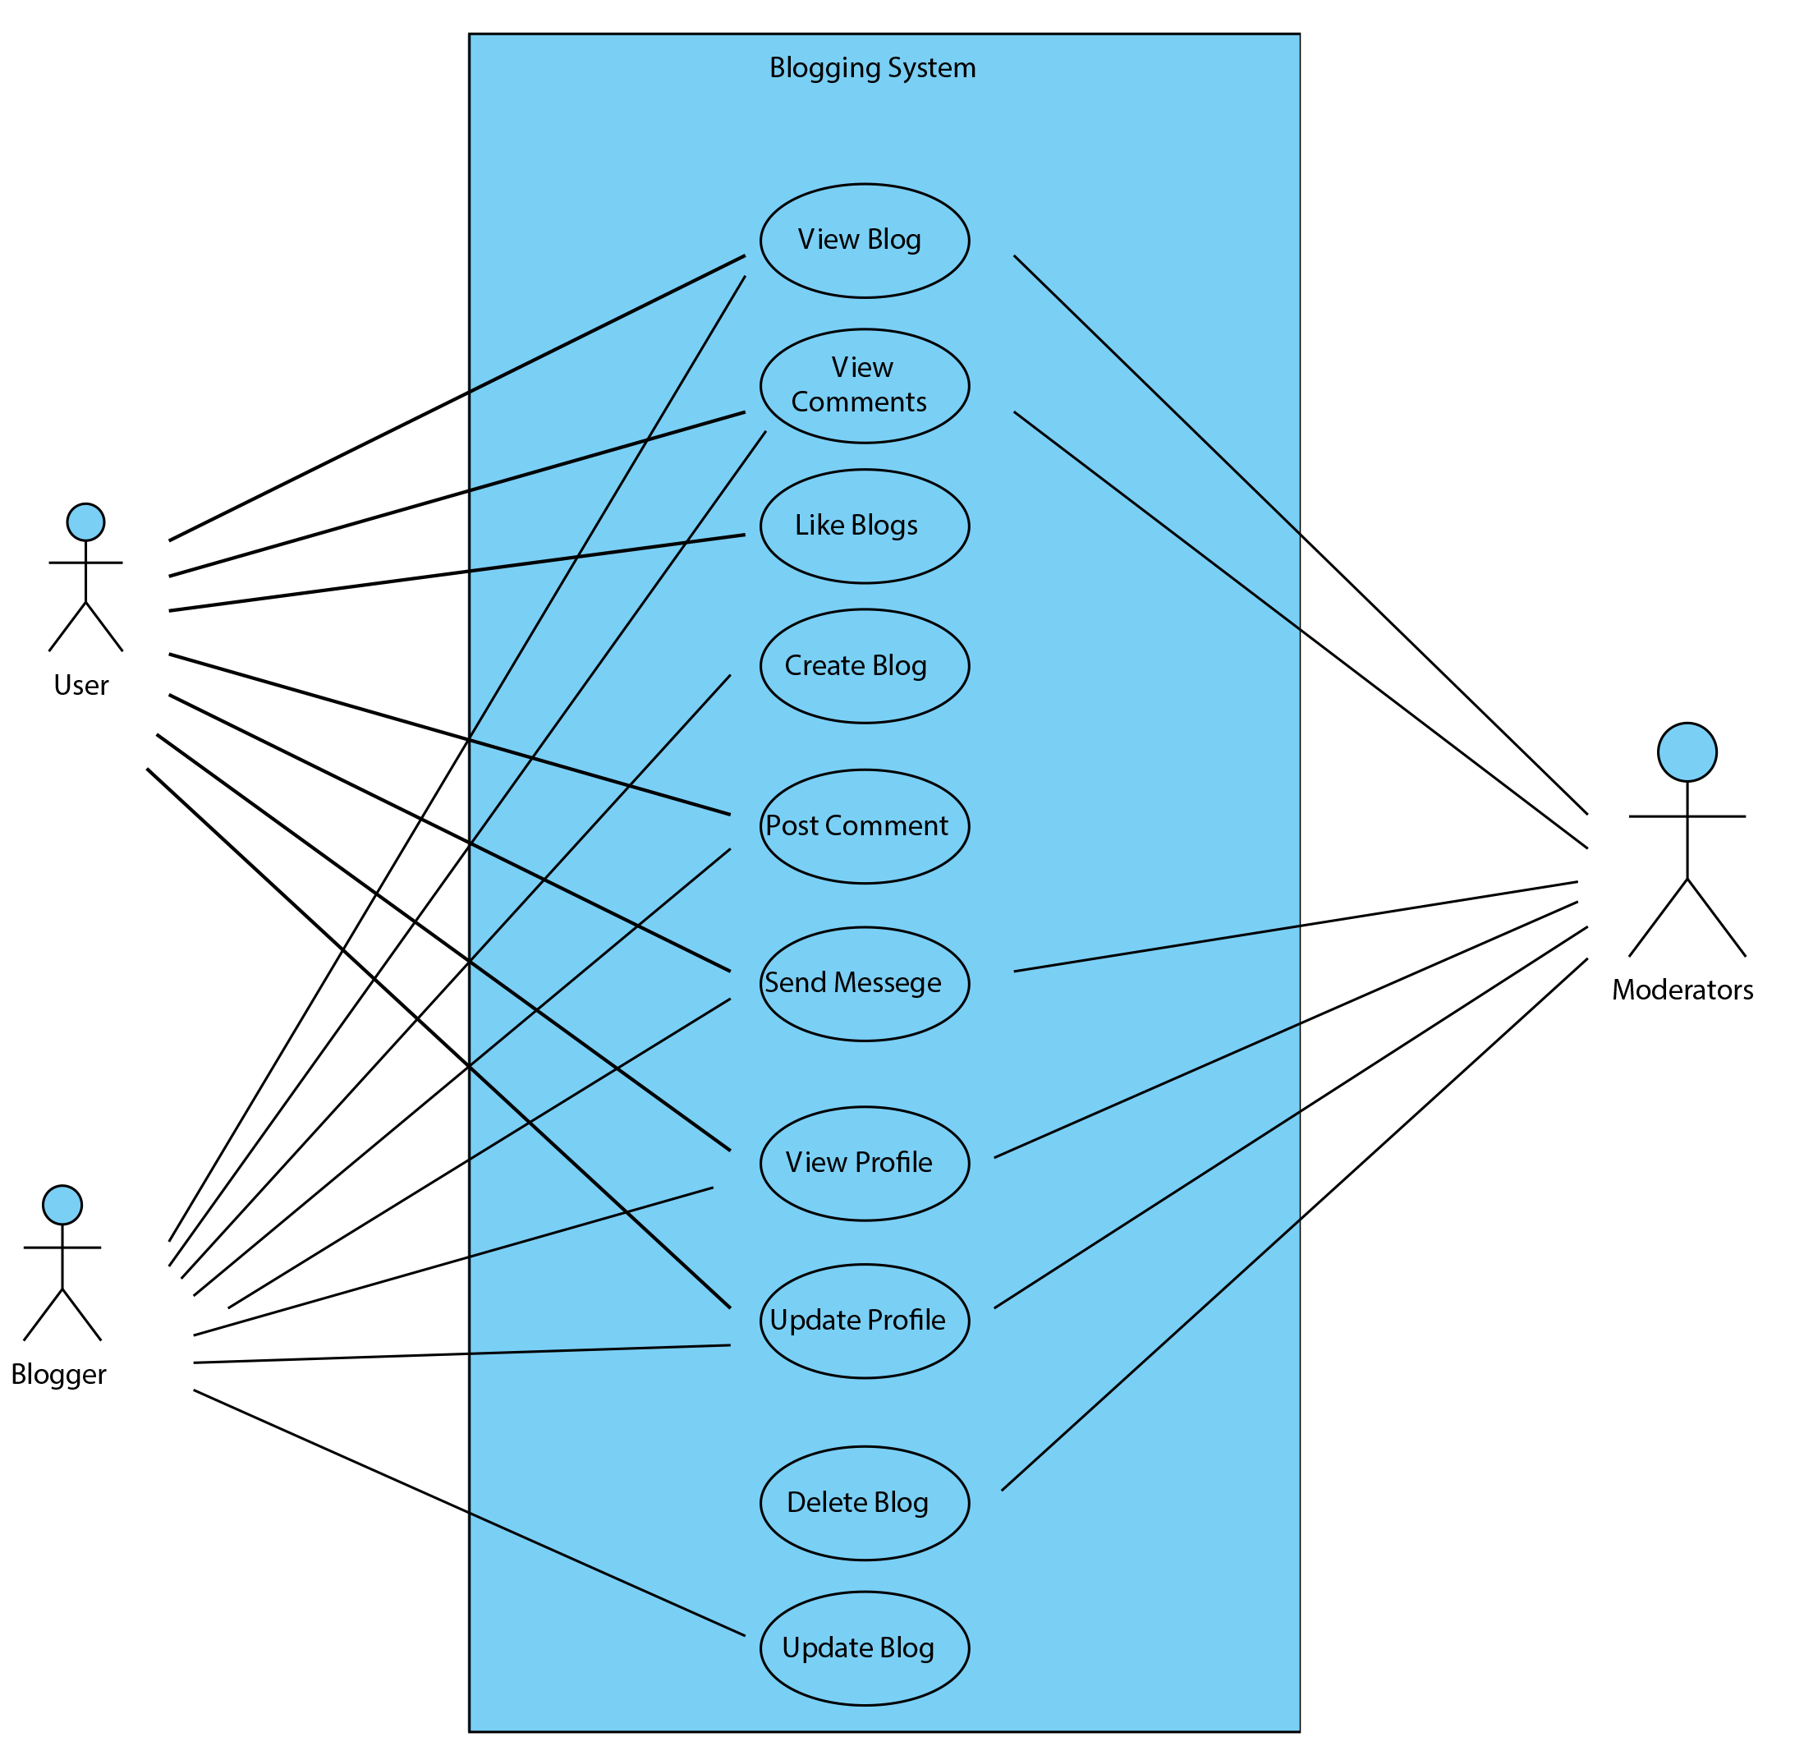
Use-Case Diagram

Slide 7
Feasibility study
Technical
The implementation of the system is adaptable to a range of current technologies and is designed to integrate with any future technologies that may be introduced.
Hardware Requirement
Dell Vostro
8 GB RAM
ii. Software Requirement
Operating System: Windows
Web Browser: IE 10 or above, Mozilla FF and above or Google Chrome
XAMPP, MySQL, Draw.io
iii. Language used: HTML, CSS, PHP, MySQL, JS

Slide 8
Feasibility study
Operational
The current mode of operation provides good throughput and response time.
We can gain significant benefits from the proposed system.
The resources available are used to the maximum capacity to deliver quality system on time.
Economic
The system is cost effective
The efficient management of rehouses will diminish the cost of this system
The benefits of this system will outweigh the costs.

Slide 9
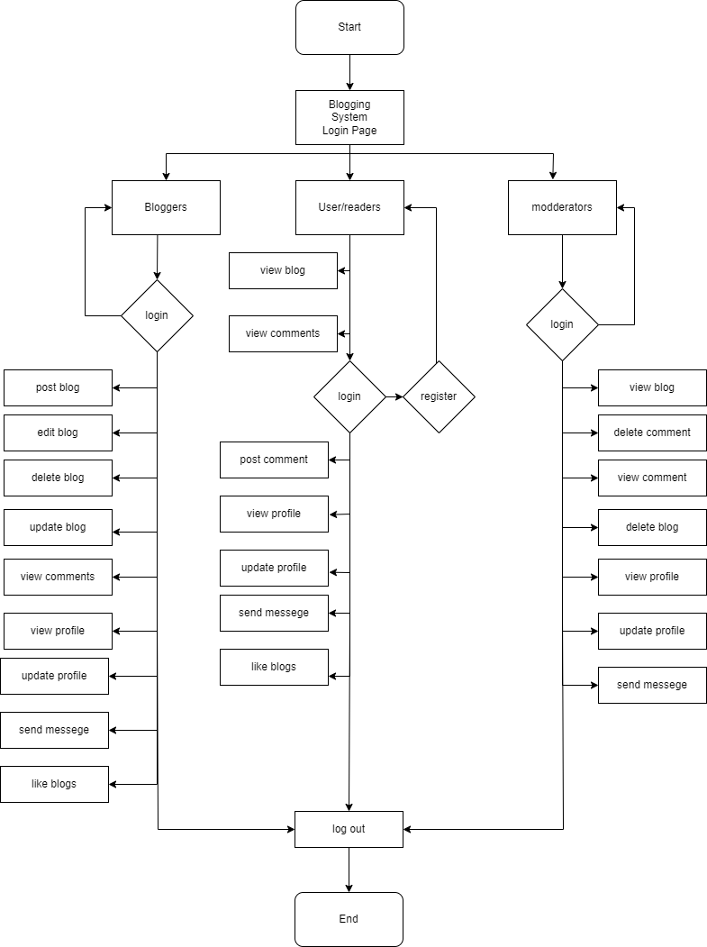
High Level Design of System

Slide 10
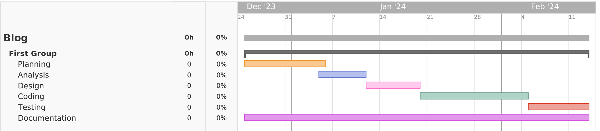
Gantt Chart

Slide 11
Expected Outcome
Enhanced Blogger Convenience: Bloggers can easily upload blogs on various topics of interest without much hassle.
Responsive System: The site will be responsive and work as intended on different devices.
Feedback and Reviews: Viewers and bloggers can communicate easily with different systems like direct messaging and comments.

Slide 12
References
[1] | S. Anderson, "mashable.com," 29 August 2019. [Online]. Available: https://mashable.com/article/best-tumblr-scams. [Accessed 22 12 2023].
[2] | J. Parson, "Content Powered," 3 November 2023. [Online]. Available: https://www.contentpowered.com/blog/reasons-blog-isnt-working/. [Accessed 25 December 2023].
[3] | N. Agarwal, "researchgate.com," 1 November 2017. [Online]. Available: https://www.researchgate.net/publication/329658800_BLOGS_FAKE_NEWS_AND_INFORMATION_ACTIVITIES. [Accessed 26 December 2023].

